Slide 1

Budget Sales Analysis

Slide 2
Introduction
This presentation will provide a comprehensive analysis of the budget sales data. We'll be covering key aspects such as territories, products, customers, and calendar trends.
Through detailed visualizations, we will uncover valuable insights to drive strategic decision-making and optimize sales performance. The goal is to gain a deep understanding of the data and identify opportunities to improve sales and profitability.
The analysis will be structured in a logical flow, starting with a high-level data overview, then diving into the specific areas of territories, products, customers, and calendar trends. We'll also take a closer look at overall sales and budget performance.
By the end of this presentation, you'll have a clear picture of the current state of the business and actionable recommendations to enhance the sales strategy moving forward.

Slide 3
Data Overview
Territories The data includes information on countries, regions, and groups, enabling us to analyze sales performance across different geographical areas. | Products The product data covers attributes like color and category, allowing us to examine sales patterns and profitability across the product portfolio. | Customers Customer data, including gender and marital status, will help us gain insights into buying behaviors and preferences. | Calendar The calendar data, with details on year, month, and date, will enable us to identify seasonal trends and understand the impact of specific events on sales.

Slide 4
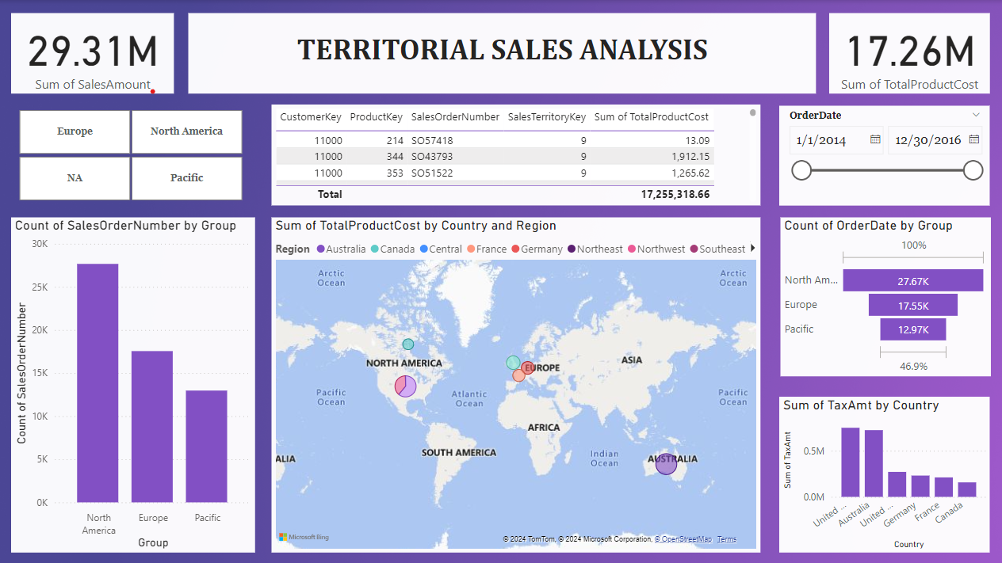
Territories Analysis
Country Analysis
We will examine sales performance across different countries, identifying top-performing and underperforming regions to allocate resources effectively.
Regional Trends
By analyzing sales data at the regional level, we can uncover emerging trends and patterns that can guide strategic planning and expansion efforts.
Group Performance
Evaluating sales across different groups will help us understand the unique dynamics and challenges faced by each segment, informing targeted initiatives.

Slide 5
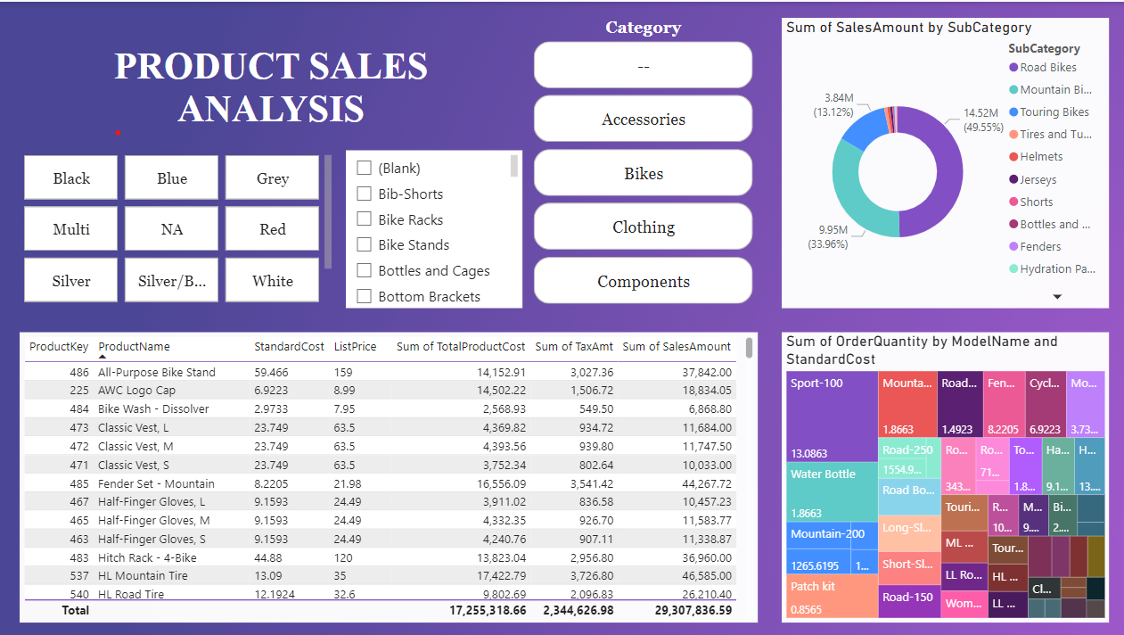
Product Analysis
Color Trends
Analyzing sales by product color will reveal customer preferences and help us optimize the product mix to align with market demands.
Category Performance
Evaluating sales and profitability across different product categories will guide investment decisions and innovation efforts.
Pricing Strategies
Understanding the relationship between price, cost, and sales will enable us to develop effective pricing strategies to maximize revenue and profitability.

Slide 6
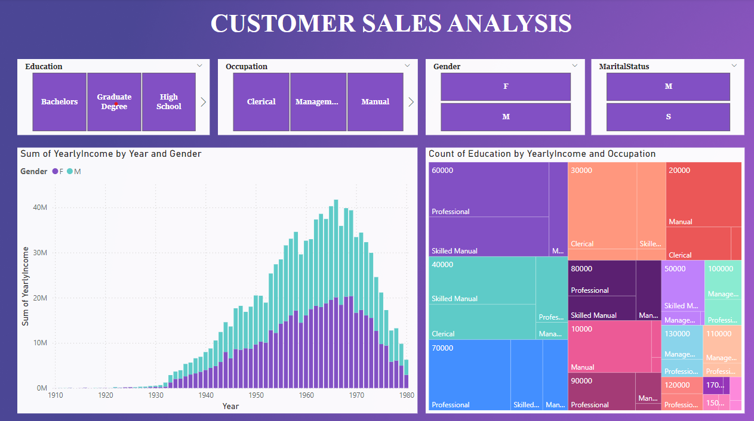
Customer Analysis
Gender Dynamics
Examining sales patterns across gender will help us tailor marketing and product strategies to better appeal to specific customer segments.
Marital Status Insights
Understanding how marital status influences purchasing decisions will enable us to develop targeted campaigns and offerings for different customer groups.
Emerging Trends
Analyzing customer data over time will uncover evolving preferences and behaviors, allowing us to anticipate and respond to changing market dynamics.

Slide 7
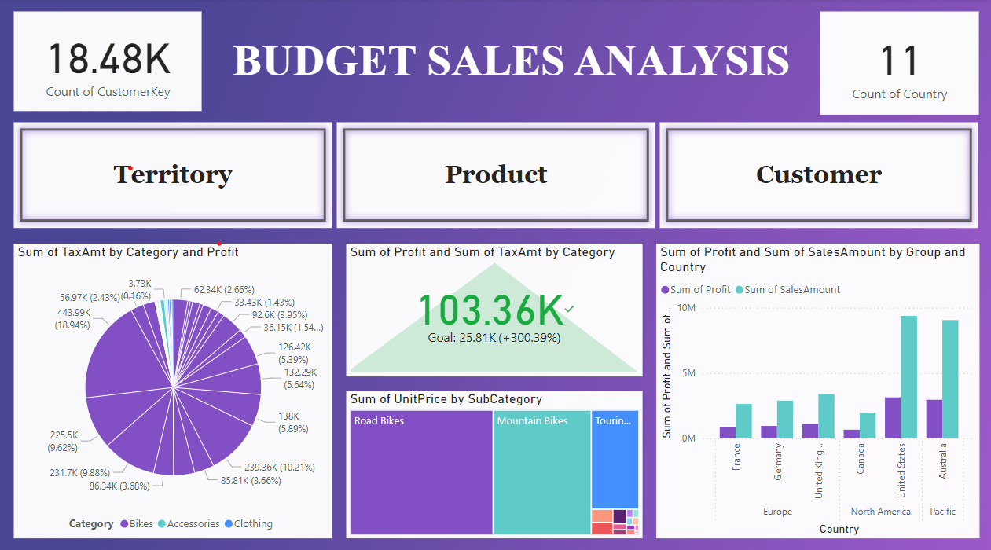
Budget Analysis
Budgeting Targets
Evaluating our performance against established budgeting goals will help us assess the effectiveness of our strategies and identify areas for improvement.
Resource Allocation
Analyzing budget utilization across different segments, such as territories, products, or marketing initiatives, will inform our resource allocation decisions.
Variance Analysis
Identifying and understanding variances between actual sales and budgeted figures will provide valuable insights to refine our forecasting and planning processes.
Cost Management
Exploring the relationship between sales, costs, and profitability will guide our efforts to optimize operational efficiency and maximize financial performance.

Slide 8
Key Insights and Findings
Growth Opportunities
Identify high-potential markets, products, and customer segments to drive sustainable growth.
Operational Optimization
Uncover areas for cost savings, inventory management, and process improvements.
Strategic Alignment
Align sales, marketing, and product strategies to better meet customer needs and market demands.
Risk Mitigation
Anticipate and address potential challenges, such as market volatility or competitive threats.

Slide 9
THANK YOU

